Slide 1
Web Application Architecture, HTTP, REST
by Rostyslav Khanas

Slide 2
AGENDA
What is Web Application Architecture?
Components of Web Applications Architectures
Types of Web Application Architecture
HTTP Protocol
REST

Slide 3
WEB APPLICATION ARCHITECTURE
Web Application Architecture is a framework that is comprised of the relationships and interactions between application components, such as middleware systems, user interfaces, and databases. Its is a Web a pattern of interaction between web application components.
In essence, Web Application Architectures can be defined with the depiction of this process:
A user browses for a specific URL, which the browser locates and requests.
Over the network, data is sent from the server to the browser, then executed by the browser so that it is able to display the requested page.
The user views and interacts with the page.

Slide 4
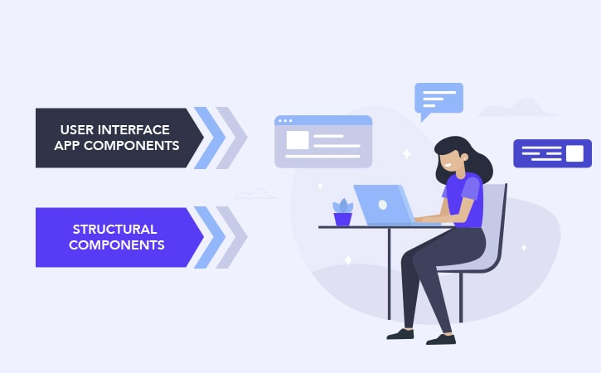
COMPONENTS
Web Application Architectures comprises various components that are segregated into two categories of components – user interface app components and structural components.

Slide 5
User interface app components refer to web pages displaying dashboards, logs, notifications, configuration settings, and more. They are not relevant to the structural development of the application and are more user interface/experience oriented.
The structural components, which are the real meat of the app development process, are:
The web browser or client - user-friendly representation of a web app’s functionality that a user interacts with. Generally, developed with HTML, CSS and JS.
The web application server - handles the central hub that supports business logic and multi-layer applications, and is generally developed using Python, PHP, Java, .NET, Ruby, and Node.js.
The database server - provides and stores relevant data for the application. Additionally, it may also supply the business logic and other information that is managed by the web application server.

Slide 6
TYPES
Regardless of the model, all web application components always work simultaneously and create an integral web app. Depending on how the app logic is distributed among the client and server sides, there can be various types of web application architecture.

Slide 7
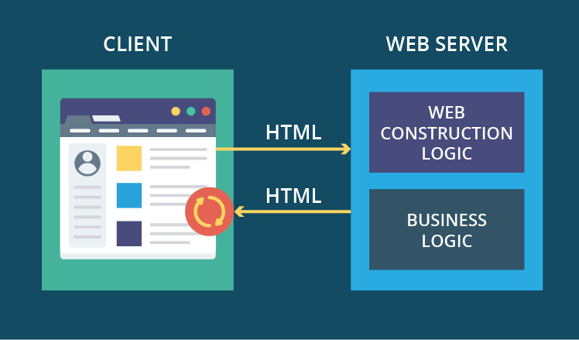
SERVER-SIDE HTML WEB APP
According to the very first and basic web app architecture, a server, consisting of web page construction logic and business logic interacts with a client by sending out a complete HTML page. To see an update, the user needs to fully reload the page or, in other words, to have the client send a request for an HTML page to the server and load its entire code once again.

Slide 8
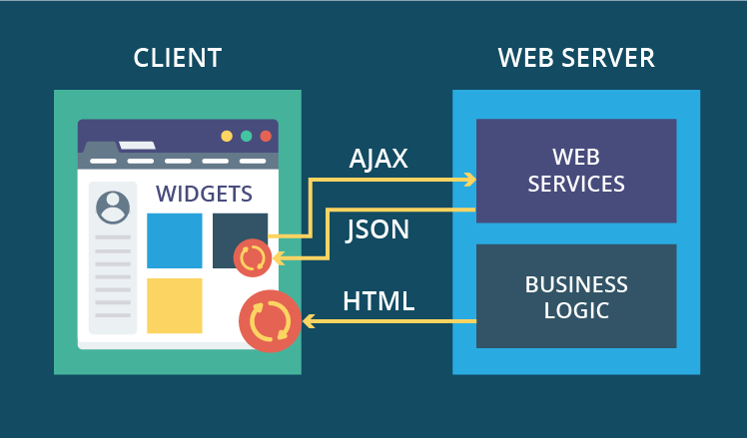
WIDGET WEB APP
In this type, the web page construction logic is replaced by web services, and each page on the client has separate entities called widgets. By sending AJAX queries to web services, widgets can receive chunks of data in HTML or JSON and display them without reloading the entire page.

Slide 9
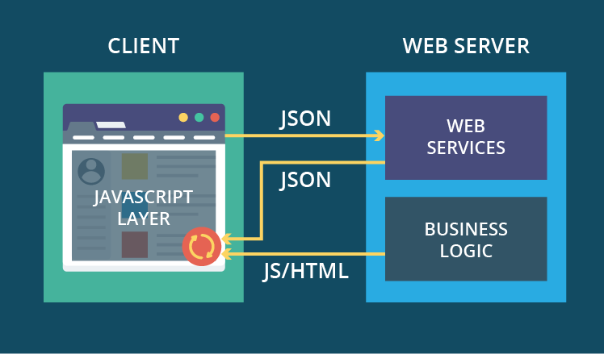
SINGLE-PAGE APP (SPA)
This is the most modern web application architecture, where you download a single page only once. On the client side, this page has a JavaScript layer that can freely communicate with web services on the server and, using the data from web services, make real-time updates to itself.
Chunks of data transferred from the server to the client here are minimal, especially compared to the first type. It’s very agile, responsive and lightweight web app.

Slide 10
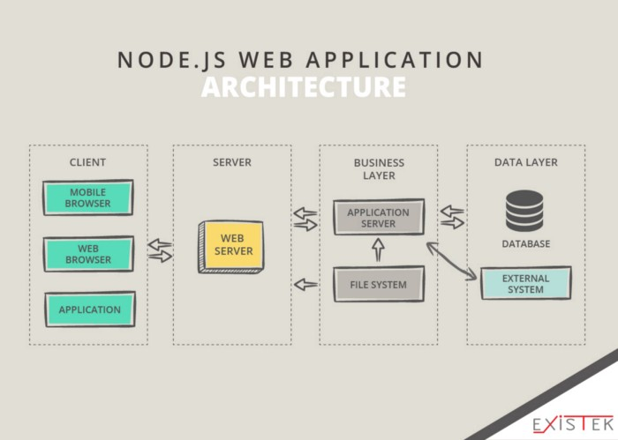
Node.js WEB APP ARCHITECTURE
The number of developers using the Node.js framework is gradually increasing due to its efficiency of the development process. This web application framework architecture could deal with different requirements concerning design and structure.
Node.js is written using JavaScript and is the same technology as frontend components, which makes it easier for the same developers to program backend services and frontend user interfaces.

Slide 11
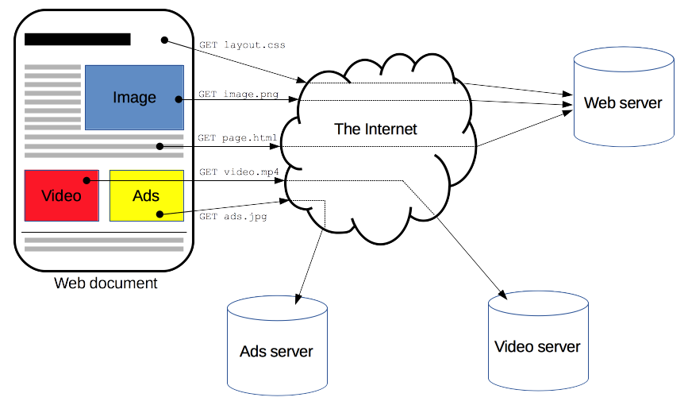
HTTP PROTOCOL
Hypertext Transfer Protocol (HTTP) is an application-layer protocol for transmitting hypermedia documents, such as HTML.
A protocol is a system of rules that define how data is exchanged within or between computers. Communications between devices require that the devices agree on the format of the data that is being exchanged. The set of rules that defines a format is called a protocol.

Slide 12
BASIC FEATURES OF HTTP
There are three basic features that make HTTP a simple but powerful protocol:
HTTP is connectionless: The HTTP client, i.e., a browser initiates an HTTP request and after a request is made, the client waits for the response. The server processes the request and sends a response back after which client disconnect the connection. So client and server knows about each other during current request and response only. Further requests are made on new connection like client and server are new to each other.

Slide 13
HTTP is media independent: It means, any type of data can be sent by HTTP as long as both the client and the server know how to handle the data content. It is required for the client as well as the server to specify the content type using appropriate MIME-type.
HTTP is stateless: As mentioned above, HTTP is connectionless and it is a direct result of HTTP being a stateless protocol. The server and client are aware of each other only during a current request. Afterwards, both of them forget about each other. Due to this nature of the protocol, neither the client nor the browser can retain information between different requests across the web pages.
HTTP/1.0 uses a new connection for each request/response exchange, where as HTTP/1.1 connection may be used for one or more request/response exchanges.

Slide 14
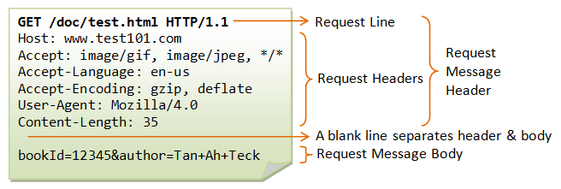
HTTP REQUEST

Slide 15
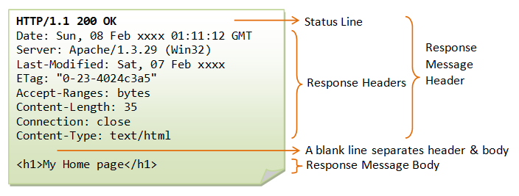
HTTP RESPONSE

Slide 16
HTTP REQUEST METHODS
GET - used to retrieve information from the given server using a given URI. Requests using GET should only retrieve data and should have no other effect on the data.
POST - used to send data to the server, for example, customer information, file upload, etc. using HTML forms.
PUT - replaces all current representations of the target resource with the uploaded content.
DELETE - removes all current representations of the target resource given by a URI.

Slide 17
HTTP STATUS CODES
1xx: Informational. It means the request has been received and the process is continuing.
2xx: Success. It means the action was successfully received, understood, and accepted.
3xx: Redirection. It means further action must be taken in order to complete the request.
4xx: Client Error. It means the request contains incorrect syntax or cannot be fulfilled.
5xx: Server Error. It means the server failed to fulfill an apparently valid request.

Slide 18
REST
REST is an architecture style for designing networked applications. It stands for REpresentational State Transfer.
REST defines 6 architectural constraints which make any web service – a true RESTful API. These constraints are:
Client-Server
Uniform Interface
Stateless
Cacheable
Layered System
Code on demand (optional)

Slide 19
REST CONSTRAINTS
Client-Server. This essentially means that client application and server application MUST be able to evolve separately without any dependency on each other. A client should know only resource URIs and that’s all.
Uniform Interface. As the constraint name itself applies, you MUST decide APIs interface for resources inside the system which are exposed to API consumers and follow religiously. A resource in the system should have only one logical URI and that should provide a way to fetch related or additional data.
Stateless. Roy Fielding, creator of REST, got inspiration from HTTP, so it reflects in this constraint. Make all client-server interaction stateless. Server will not store anything about latest HTTP request client made. It will treat each and every request as new. No session, no history.

Slide 20
REST CONSTRAINTS
Cacheable. Caching brings performance improvement for client side, and better scope for scalability for a server because the load has reduced. In REST, caching shall be applied to resources when applicable and then these resources MUST declare themselves cacheable. Caching can be implemented on the server or client side.
Layered system
REST allows you to use a layered system architecture where you deploy the APIs on server A, and store data on server B and authenticate requests in Server C, for example. A client cannot ordinarily tell whether it is connected directly to the end server, or to an intermediary along the way.
Code on demand (optional). Most of the time you will be sending the static representations of resources in form of XML or JSON. But when you need to, you are free to return executable code to support a part of your application e.g. clients may call your API to get a UI widget rendering code. It is permitted.

Slide 21
REST PRINCIPLES
Use meaningful HTTP verbs.
Sensible resource names.
XML and JSON
Create Fine-Grained Resources

Slide 22
THANKS!

